Slide 1

IWD ASSIGNMENT
BY- Harssahil Singh(1531054) and Mojeeb Noutash()

Slide 2
ISCG 6420 ASSIGNMENT
Part 1- Booking System for the Mermaids Piha Lodges.
Part 2- Game

Slide 3
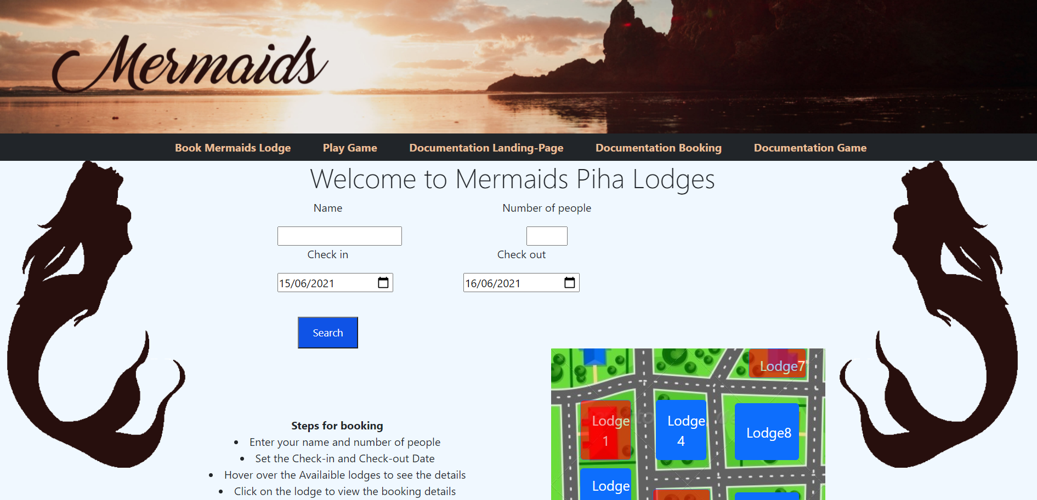
Landing Page
The landing Page includes the booking system itself and has a navigation bar which takes the user to the game. The documentation related to both of the parts are also attached.

Slide 4
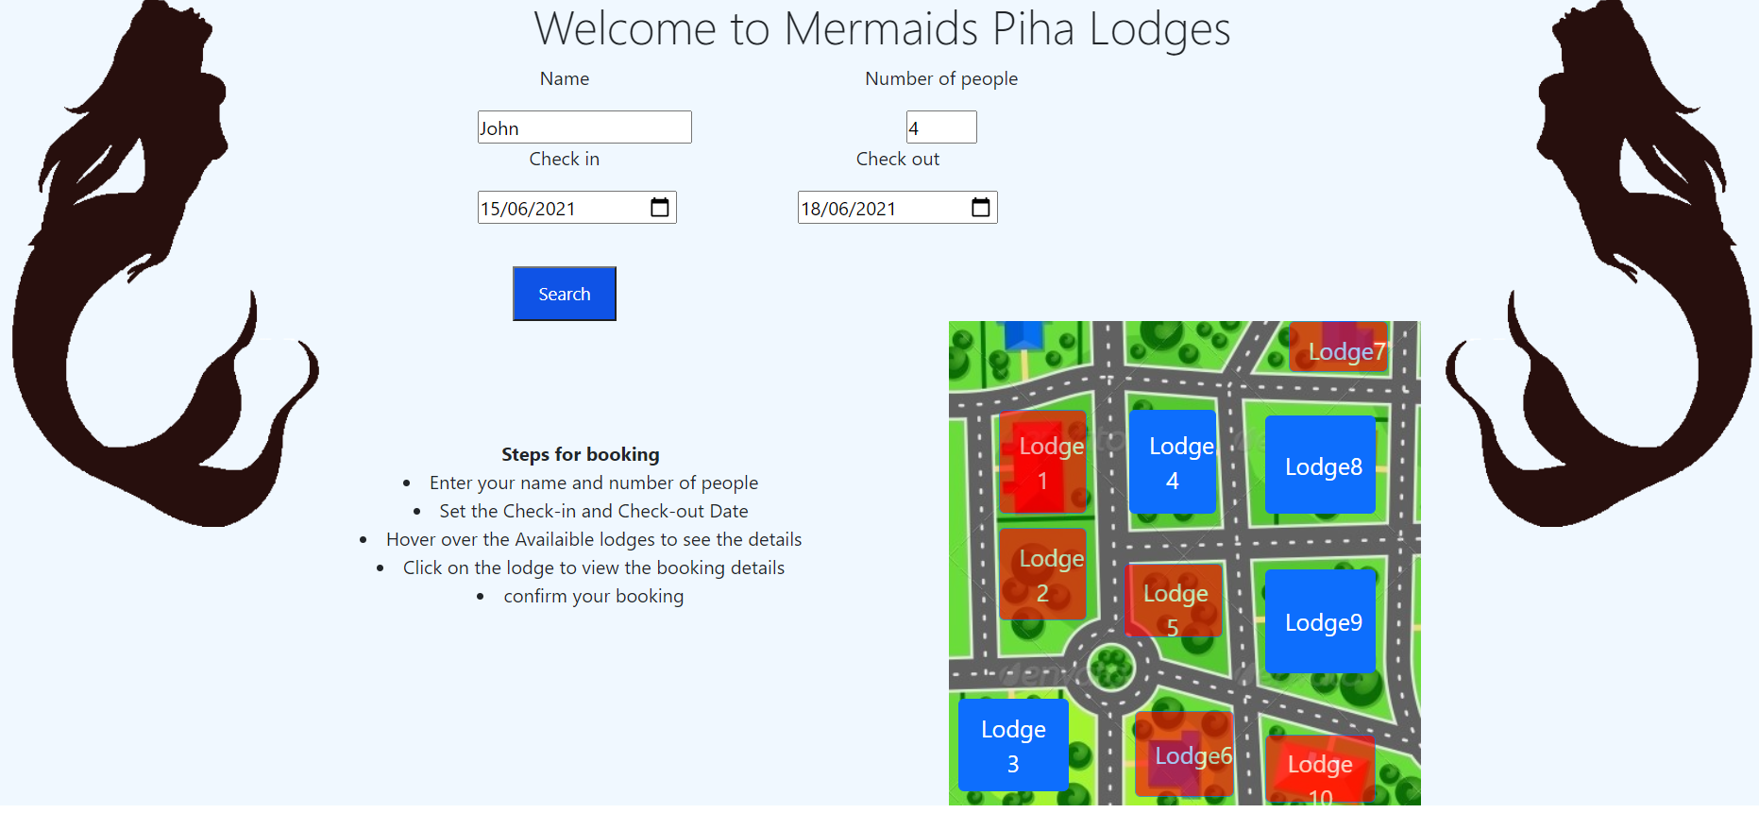
Part 1 – Booking System
The Booking System allows the user to enter their details to start the booking.
Three lodges are already booked meeting the requirements, so user cant book those lodges.

Slide 5
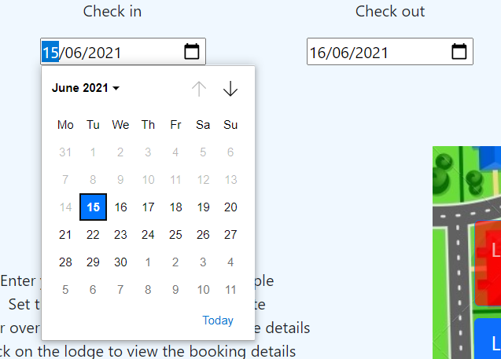
Restricting the check-in and Check-out Dates
The date is set to today and tomorrow by default and the user cannot select the previous dates.

Slide 6
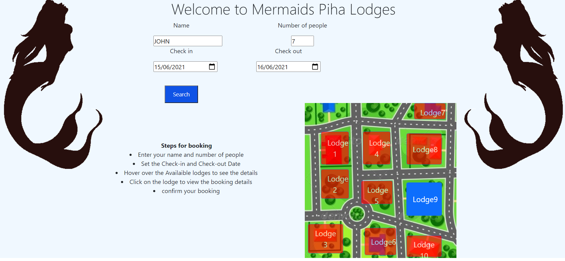
Checking The Availability of Lodges
The user is not able to book the lodges whose capacity is less than the number of people.
All the unavailable lodges turn red and user is no longer able to book them.

Slide 7
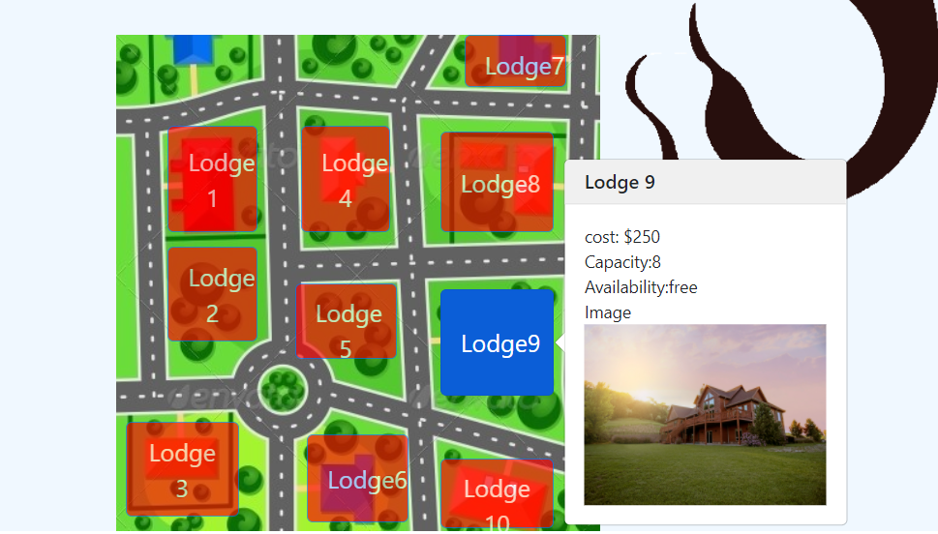
Displaying the Data of the Available Lodges
The user can see the data of the available lodges by simply hovering over the lodge.

Slide 8
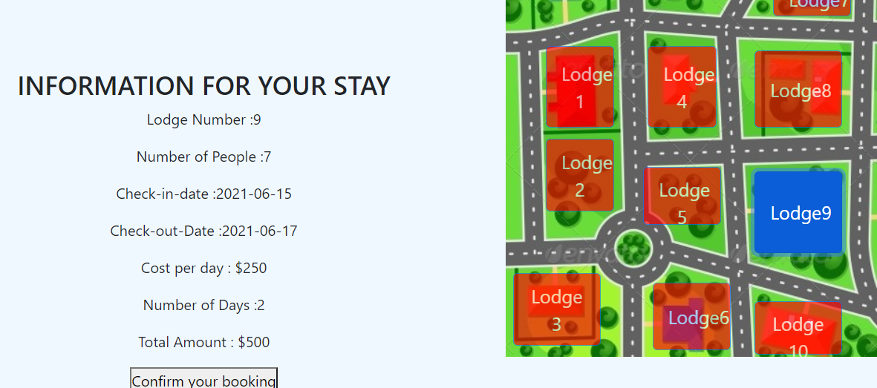
Selecting the available lodge to see details
The user can simply click on an available lodge to see all the related details for his stay.
To confirm the booking the user has to click on ‘Confirm Your Booking’ Button.

Slide 9
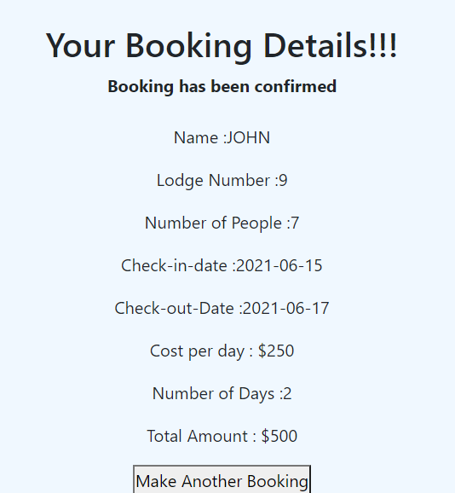
Booking confirmation
Now, the user can see the booking confirmation with all the details about the booking displayed to him.
Incase, the user wants to book an another lodge; he has to click on ”Make Another Booking” Button.

Slide 10
Make Another Booking
Once the user clicks on make another booking button, it takes user back to the start allowing him to make another booking

Slide 11
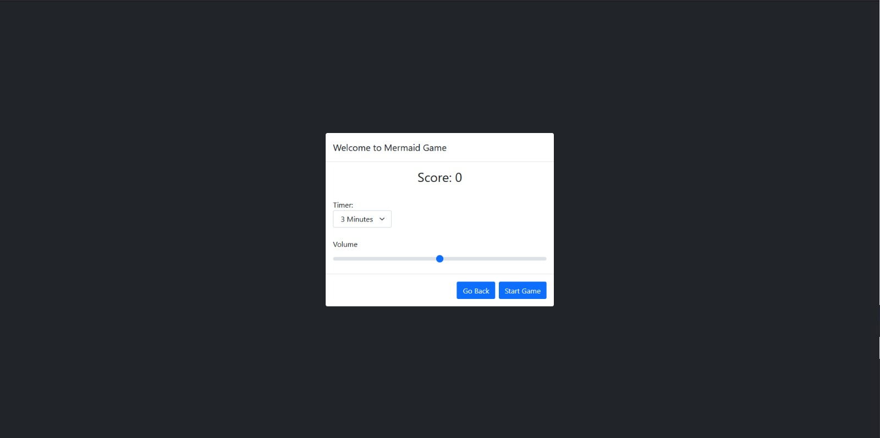
Part 2- Game
The menu appears when the game starts which allows the user to set the timer and sound for the game.

Slide 12
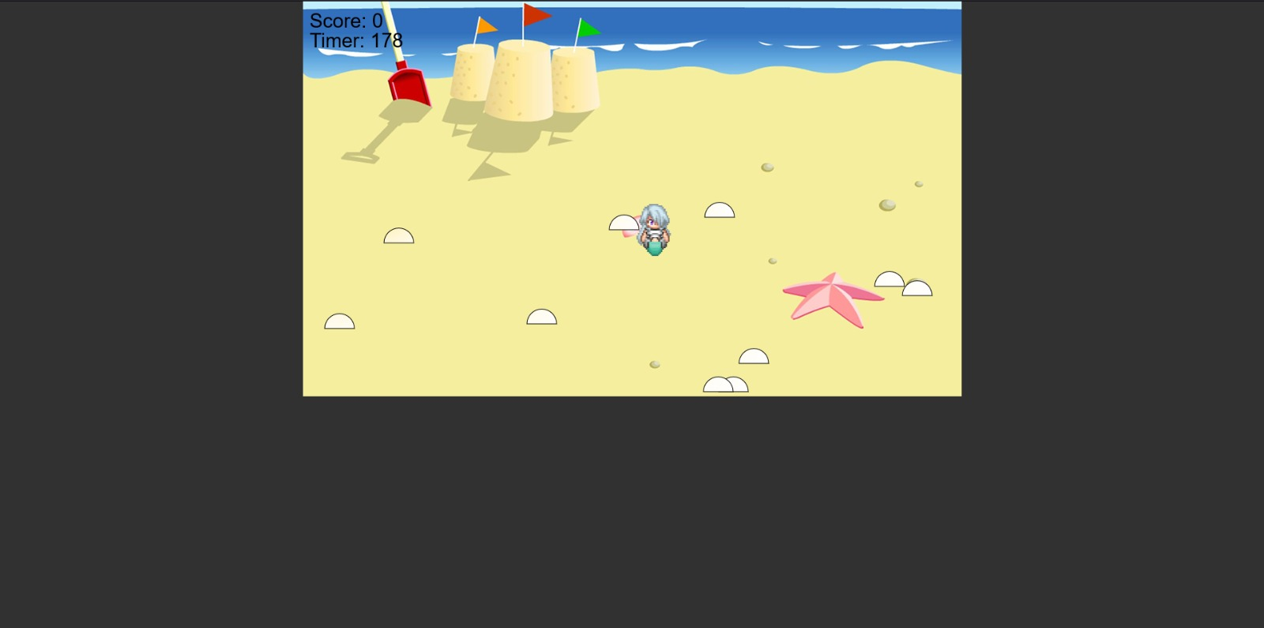
Playing the Game

Slide 13

End of the game
At the end of the game another menu appears that shows the user his total score and gives the option to go back or restart the game.

Slide 14
Demonstration Time!!!

